Slide 1

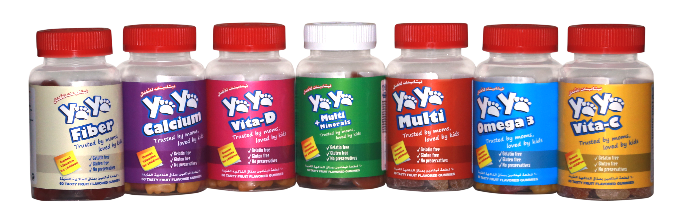

Slide 2
Product Brief
Essential Vitamins Formula for Kids health Supply
Made in Canada
Number one prescribed Gummy multivitamins, available in all key account Pharmacies over UAE
Gelatin, Gluten and preservatives free
Available in 5 variants ( Vitamins and Minerals)

Slide 3
How to be taken?
60 Tasty Fruit Flavored Gummies
To be taken on daily basis for kids of 2 Y. O. – 10 Years old
One or Two gummies per day.

Slide 4
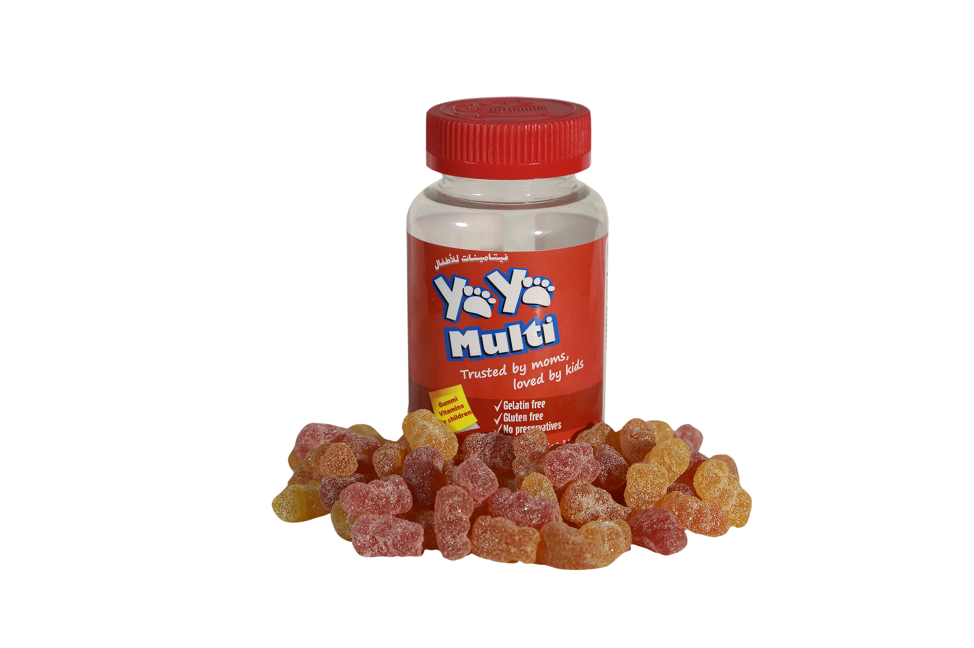
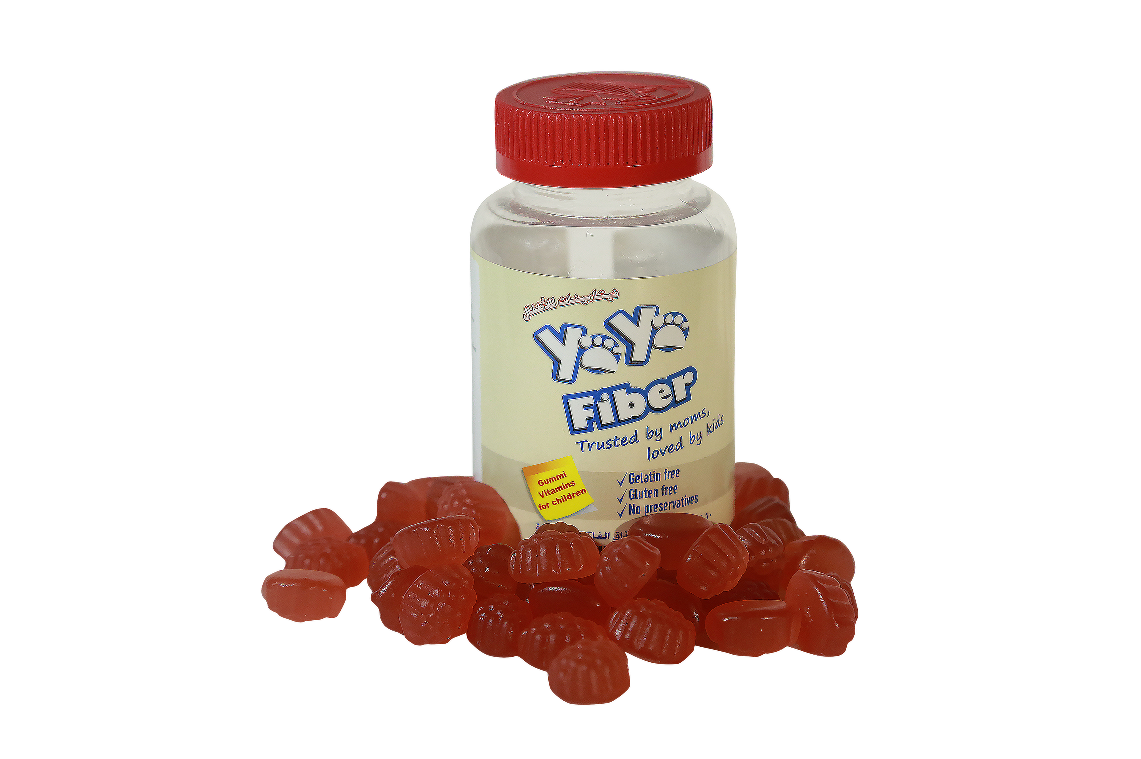
Our Products
YaYa Multi
YaYa Fiber

Slide 5
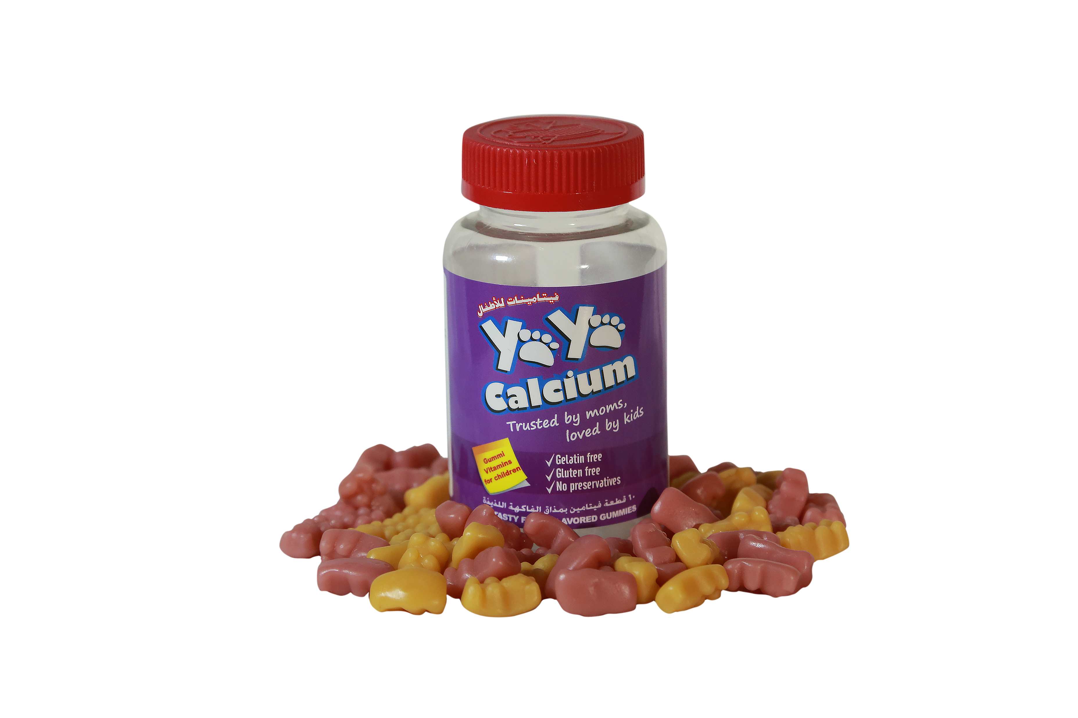
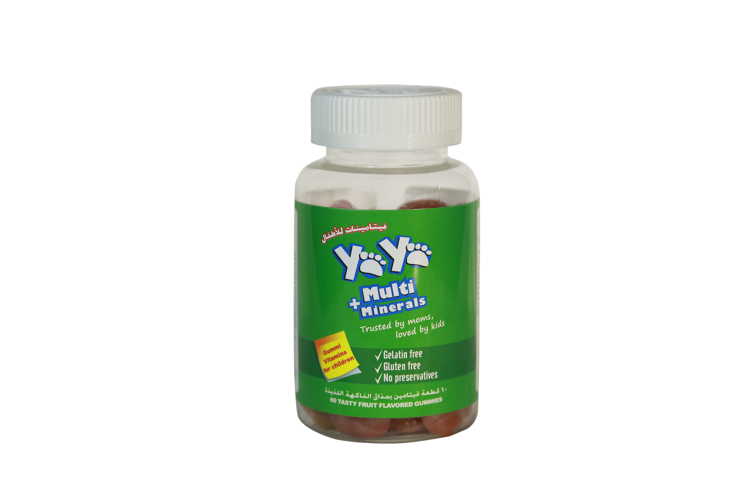
Our Products
YaYa Calcium
YaYa Multi
+ Minerals

Slide 6
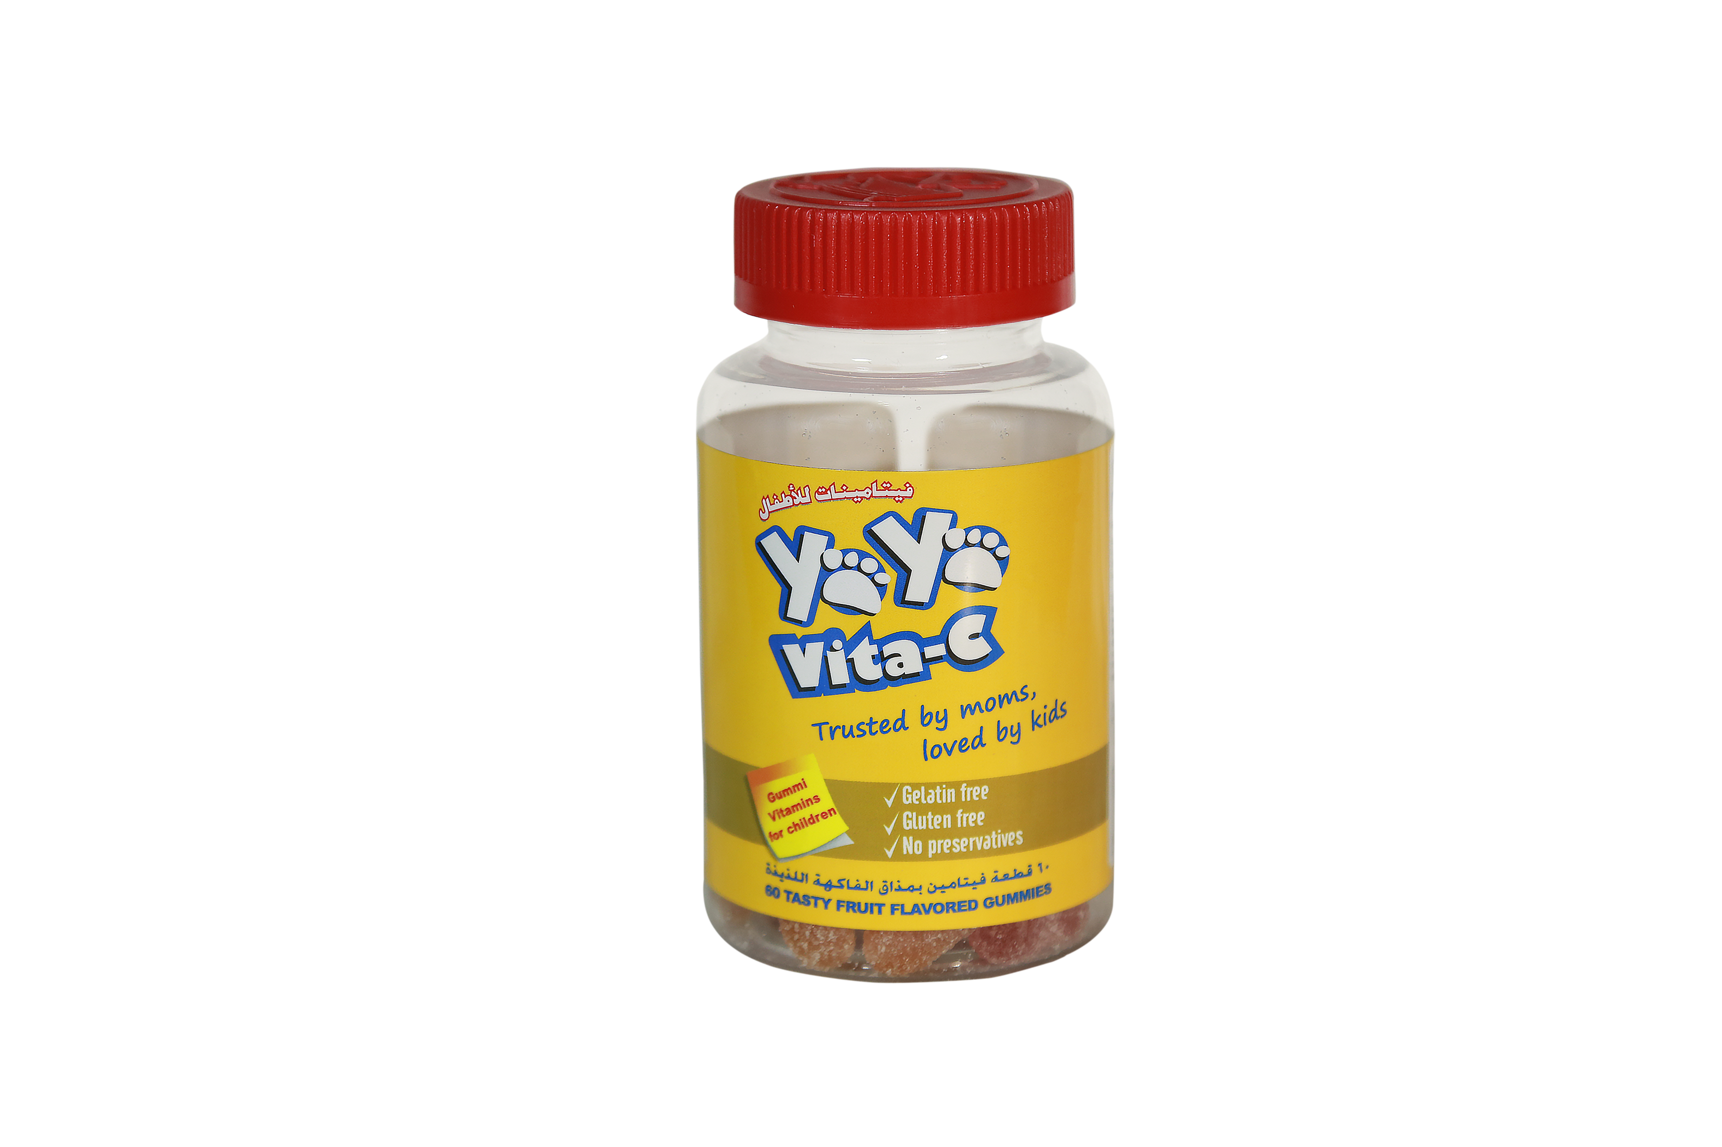
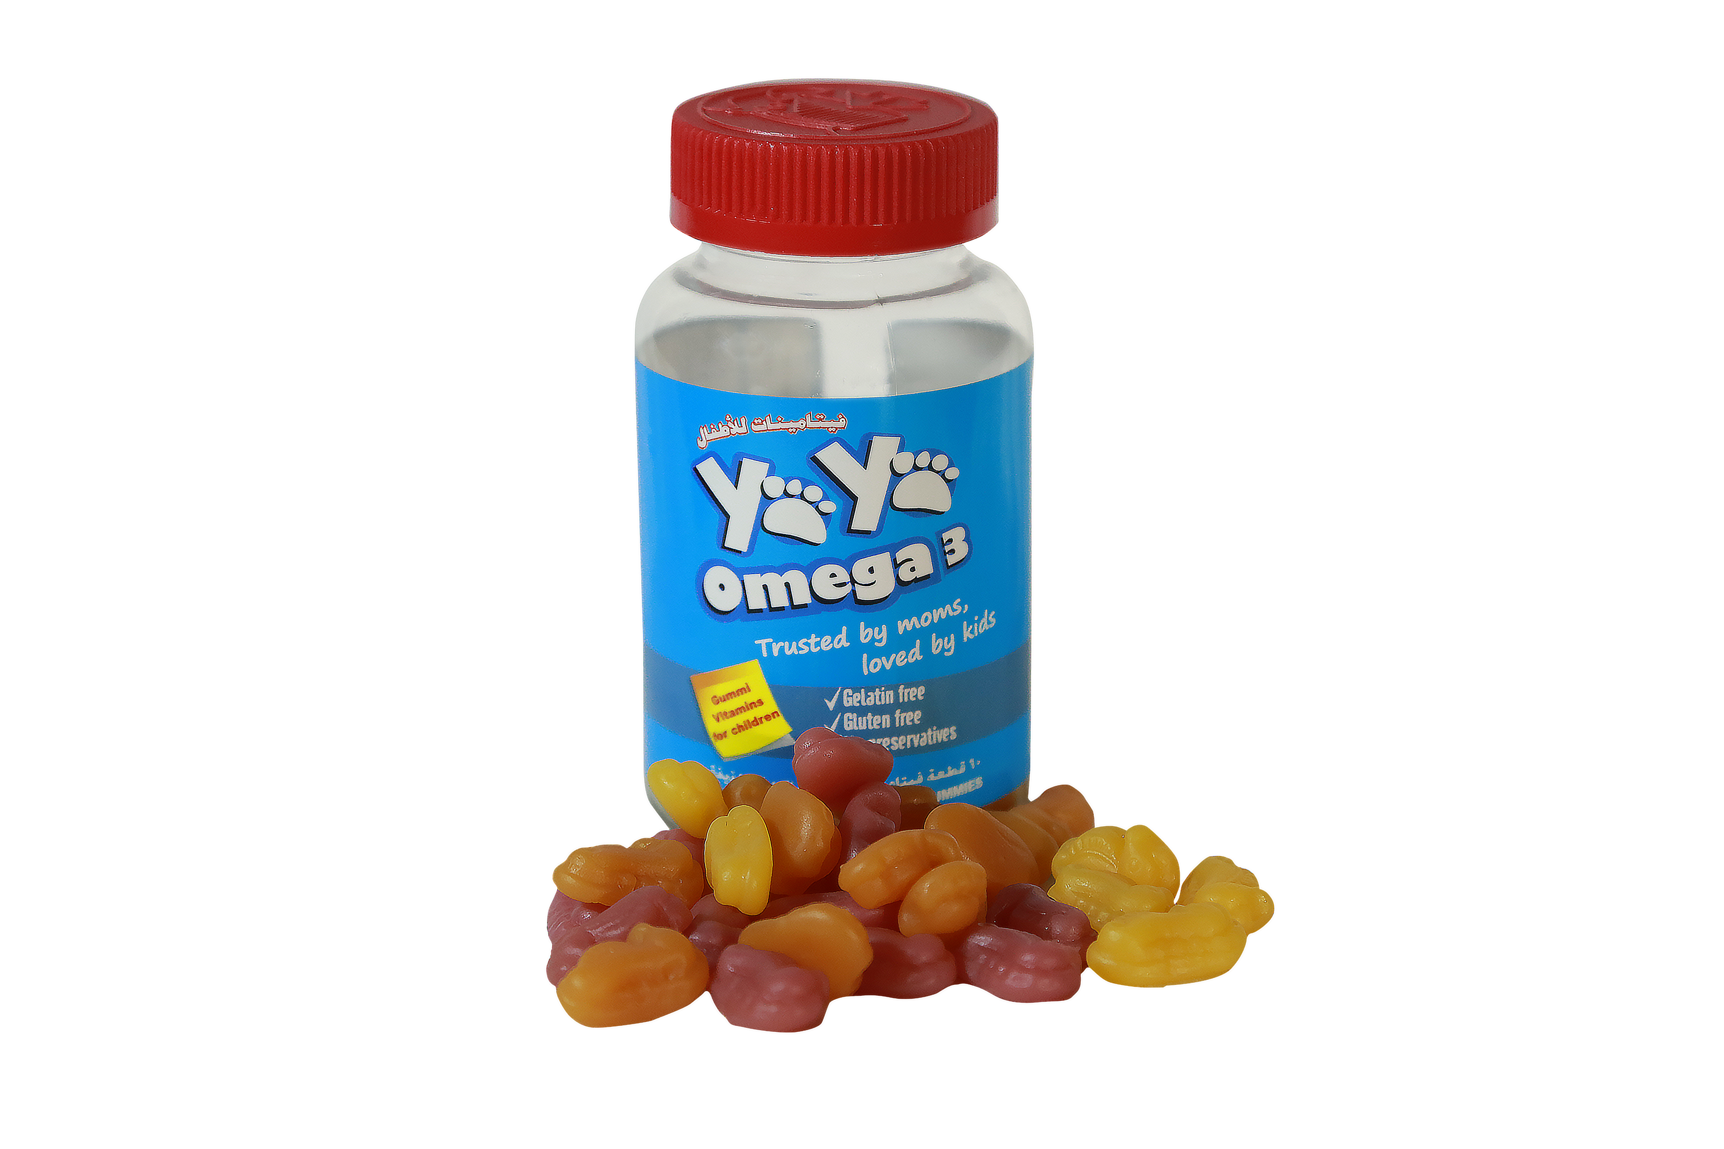
Our Products
YaYa Omega 3
YaYa Vita-C

Slide 7
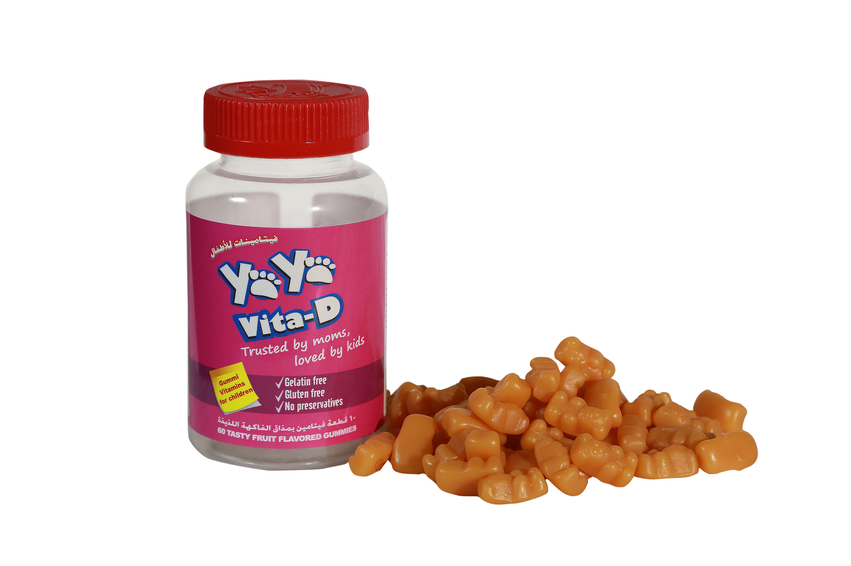
Our Products
YaYa Vita-D

